Slide 1
Chapter 10
Program Organization

Slide 2
Local Variables
A variable declared in the body of a function is said to be local to the function:
int sumDigits(int n)
{
int sum = 0; /* local variable */
while (n > 0) {
sum += n % 10;
n /= 10;
}
return sum;
}
Automatic storage duration
Block scope

Slide 3
Local Variables
Default properties of local variables:
Automatic storage duration
Storage is “automatically” allocated when the enclosing function is called and deallocated when the function returns.
Block scope
A local variable is visible from its point of declaration to the end of the enclosing function body.

Slide 4
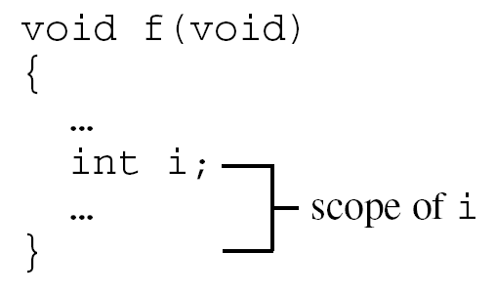
Local Variables
Since C99 doesn’t require variable declarations to come at the beginning of a function, it’s possible for a local variable to have a very small scope:

Slide 5
Static Local Variables
Including static in the declaration of a local variable causes it to have static storage duration.
A variable with static storage duration has a permanent storage location, so it retains its value throughout the execution of the program.
Example:
void f(void)
{
static int i; /* static local variable */
…
}
A static local variable still has block scope, so it’s not visible to other functions.

Slide 6
Parameters
Parameters have the same properties—automatic storage duration and block scope—as local variables.
Each parameter is initialized automatically when a function is called (by being assigned the value of the corresponding argument).

Slide 7
Local, static variable demo
#include <stdio.h>
void XX(int i)
{
i = 10;
int j = 20;
printf("in XX() j=%d\n", ++j);
}
int main()
{
int i = 30, j = 30, k = 30;
XX(10);
printf("i=%d, j=%d, k=%d\n", i, j, k);
XX(10);
printf("i=%d, j=%d, k=%d\n", i, j, k);
return 0;
}
#include <stdio.h>
void XX(int i)
{
i = 10;
static int j = 20;
printf("in XX() j=%d\n", ++j);
}
int main()
{
int i = 30, j = 30, k = 30;
XX(10);
printf("i=%d, j=%d, k=%d\n", i, j, k);
XX(10);
printf("i=%d, j=%d, k=%d\n", i, j, k);
return 0;
}

Slide 8
External Variables
Passing arguments is one way to transmit information to a function.
Functions can also communicate through external variables—variables that are declared outside the body of any function.
External variables are sometimes known as global variables.

Slide 9
External Variables
Properties of external variables:
Static storage duration
File scope
file scope
means that an external variable is visible from its point of declaration to the end of the enclosing file.

Slide 10
External Variable Demo
in XX() i=11, j=21, extVar=101
i=30, j=30, extVar=101
in XX() i=11, j=22, extVar=102
i=30, j=30, extVar=102
#include <stdio.h>
int extVar = 100; // external variable
void XX(int i)
{
i++;
static int j = 20;
j++;
printf("in XX() i=%d, j=%d, extVar=%d\n", i, j, ++extVar);
}
int main()
{
int i = 30;
int j = 30;
XX(10);
printf("i=%d, j=%d, extVar=%d\n", i, j, extVar);
XX(10);
printf("i=%d, j=%d, extVar=%d\n", i, j, extVar);
return 0;
}

Slide 11
Example: Using External Variables to Implement a Stack
To illustrate how external variables might be used, let’s look at a data structure known as a stack.
A stack, like an array, can store multiple data items of the same type.
The operations on a stack are limited:
Push an item (add it to one end—the “stack top”)
Pop an item (remove it from the same end)
Examining or modifying an item that’s not at the top of the stack is forbidden.

Slide 12
Example: Using External Variables to Implement a Stack
One way to implement a stack in C is to store its items in an array, which we’ll call contents.
A separate integer variable named top marks the position of the stack top.
When the stack is empty, top has the value 0.
To push an item: Store it in contents at the position indicated by top, then increment top.
To pop an item: Decrement top, then use it as an index into contents to fetch the item that’s being popped.

Slide 13
Example: Using External Variables to Implement a Stack
The following program fragment declares the contents and top variables for a stack.
It also provides a set of functions that represent stack operations.
All five functions need access to the top variable, and two functions need access to contents, so contents and top will be external.

Slide 14
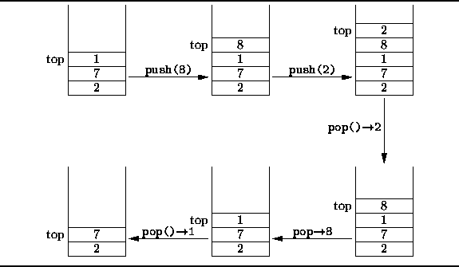
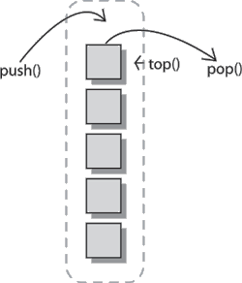

Slide 15
Example: Using External Variables to Implement a Stack
bool is_full(void)
{
return top == STACK_SIZE;
}
void push(int i)
{
if (is_full())
stack_overflow();
else
contents[top++] = i;
}
int pop(void)
{
if (is_empty())
stack_underflow();
else
return contents[--top];
}
#include <stdbool.h> /* C99 only */
#define STACK_SIZE 100
/* external variables */
int contents[STACK_SIZE];
int top = 0;
void make_empty(void)
{
top = 0;
}
bool is_empty(void)
{
return top == 0;
}

Slide 16
Pros and Cons of External Variables
External variables are convenient when many functions must share a variable or when a few functions share a large number of variables.
In most cases, it’s better for functions to communicate through parameters rather than by sharing variables:
If we change an external variable during program maintenance (by altering its type, say), we’ll need to check every function in the same file to see how the change affects it.
If an external variable is assigned an incorrect value, it may be difficult to identify the guilty function.
Functions that rely on external variables are hard to reuse in other programs.

Slide 17
Pros and Cons of External Variables
Don’t use the same external variable for different purposes in different functions.
Suppose that several functions need a variable named i to control a for statement.
Instead of declaring i in each function that uses it, some programmers declare it just once at the top of the program.
This practice is misleading; someone reading the program later may think that the uses of i are related, when in fact they’re not.

Slide 18
Pros and Cons of External Variables
Make sure that external variables have meaningful names.
Local variables don’t always need meaningful names: it’s often hard to think of a better name than i for the control variable in a for loop.

Slide 19
Pros and Cons of External Variables
Making variables external when they should be local can lead to some rather frustrating bugs.
Code that is supposed to display a 10 × 10 arrangement of asterisks:
int i;
void printOneRow(void)
{
for (i = 1; i <= 10; i++)
printf("*");
}
void printAllRows(void)
{
for (i = 1; i <= 10; i++) {
printOneRow();
printf("\n");
}
}
Instead of printing 10 rows, printAllRows() prints only one.

Slide 20
Program: Guessing a Number
The guess.c program generates a random number between 1 and 100, which the user attempts to guess in as few tries as possible:
Guess the secret number between 1 and 100.
A new number has been chosen.
Enter guess: 55
Too low; try again.
Enter guess: 65
Too high; try again.
Enter guess: 60
Too high; try again.
Enter guess: 58
You won in 4 guesses!

Slide 21
Program: Guessing a Number
Play again? (Y/N) y
A new number has been chosen.
Enter guess: 78
Too high; try again.
Enter guess: 34
You won in 2 guesses!
Play again? (Y/N) n
Tasks to be carried out by the program:
Initialize the random number generator
Choose a secret number
Interact with the user until the correct number is picked
Each task can be handled by a separate function.

Slide 22
#include <stdio.h>
#include <stdlib.h>
#include <time.h>
#define MAX_NUMBER 100
int secretNumber; // external variable
/* prototypes */
void initializeNumberGenerator(void);
void chooseNewSecretNumber(void);
void readGuesses(void);
int main(void)
{
char command;
printf("Guess the secret number between 1 and %d.\n\n",
MAX_NUMBER);
initializeNumberGenerator();
do {
chooseNewSecretNumber();
printf("A new number has been chosen.\n");
readGuesses();
printf("Play again? (Y/N) ");
scanf(" %c", &command);
printf("\n");
} while (command == 'y' || command == 'Y');
return 0;
}
guess.c

Slide 23
/**********************************************************
* initializeNumberGenerator: Initializes the random *
* number generator using *
* the time of day. *
**********************************************************/
void initializeNumberGenerator(void)
{
srand((unsigned) time(NULL));
}
//*********************************************************
// chooseNewSecretNumber: Randomly selects a number
// between 1 and MAX_NUMBER and
// stores it in secretNumber.
//**********************************************************
void chooseNewSecretNumber(void)
{
secretNumber = rand() % MAX_NUMBER + 1;
}

Slide 24
/**********************************************************
* readGuesses: Repeatedly reads user guesses and tells *
* the user whether each guess is too low, *
* too high, or correct. When the guess is *
* correct, prints the total number of *
* guesses and returns. *
**********************************************************/
void readGuesses(void)
{
int guess, numOfGuesses = 0;
for (;;) {
numOfGuesses++;
printf("Enter guess: ");
scanf("%d", &guess);
if (guess == secretNumber) {
printf("You won in %d guesses!\n\n", numGuesses);
return;
} else if (guess < secretNumber)
printf("Too low; try again.\n");
else
printf("Too high; try again.\n");
}
}

Slide 25
Program: Guessing a Number
Although guess.c works fine, it relies on the external variable secretNumber.
By altering chooseNewSecretNumber and readGuesses slightly, we can move secretNumber into the main function.
The new version of guess.c follows, with changes in bold.

Slide 26
/* Asks user to guess a hidden number */
#include <stdio.h>
#include <stdlib.h>
#include <time.h>
#define MAX_NUMBER 100
/* prototypes */
void initializeNumberGenerator(void);
int newSecretNumber(void);
void readGuesses(int secretNumber);
guess2.c

Slide 27
int main(void)
{
char command;
int secretNumber;
printf("Guess the secret number between 1 and %d.\n",
MAX_NUMBER);
initializeNumberGenerator();
do {
secretNumber = newSecretNumber();
printf("A new number has been chosen.\n");
readGuesses(secretNumber);
printf("Play again? (Y/N) ");
scanf(" %c", &command);
printf("\n");
} while (command == 'y' || command == 'Y');
return 0;
}

Slide 28
/**********************************************************
* initializeNumberGenerator: Initializes the random *
* number generator using *
* the time of day. *
**********************************************************/
void initializeNumberGenerator(void)
{
srand((unsigned) time(NULL));
}
/**********************************************************
* newSecretNumber: Returns a randomly chosen number *
* between 1 and MAX_NUMBER. *
**********************************************************/
int newSecretNumber(void)
{
return rand() % MAX_NUMBER + 1;
}

Slide 29
/**********************************************************
* read_guesses: Repeatedly reads user guesses and tells *
* the user whether each guess is too low, *
* too high, or correct. When the guess is *
* correct, prints the total number of *
* guesses and returns. *
**********************************************************/
void readGuesses(int secretNumber)
{
int guess, numGuesses = 0;
for (;;) {
numGuesses++;
printf("Enter guess: ");
scanf("%d", &guess);
if (guess == secretNumber) {
printf("You won in %d guesses!\n\n", numGuesses);
return;
} else if (guess < secretNumber)
printf("Too low; try again.\n");
else
printf("Too high; try again.\n");
}
}

Slide 30
Blocks
In Section 5.2, we encountered compound statements of the form
{ statements }
C allows compound statements to contain declarations as well as statements:
{ declarations statements }
This kind of compound statement is called a block.

Slide 31
Blocks
Example of a block:
if (i > j)
{
/* swap values of i and j */
int temp = i;
i = j;
j = temp;
}
Storage: automatic,
Scope: block scope

Slide 32
Blocks
By default, the storage duration of a variable declared in a block is automatic: storage for the variable is allocated when the block is entered and deallocated when the block is exited.
The variable has block scope; it can’t be referenced outside the block.
A variable that belongs to a block can be declared static to give it static storage duration.

Slide 33
Blocks
The body of a function is a block.
Blocks are also useful inside a function body when we need variables for temporary use.
Advantages of declaring temporary variables in blocks:
Avoids cluttering declarations at the beginning of the function body with variables that are used only briefly.
Reduces name conflicts.
C99 allows variables to be declared anywhere within a block.

Slide 34
Scope
In a C program, the same identifier may have several different meanings.
C’s scope rules enable the programmer (and the compiler) to determine which meaning is relevant at a given point in the program.
The most important scope rule: When a declaration inside a block names an identifier that’s already visible, the new declaration temporarily “hides” the old one, and the identifier takes on a new meaning.
At the end of the block, the identifier regains its old meaning.

Slide 35
Scope
In the example on the next slide, the identifier i has four different meanings:
In Declaration 1, i is a variable with static storage duration and file scope.
In Declaration 2, i is a parameter with block scope.
In Declaration 3, i is an automatic variable with block scope.
In Declaration 4, i is also automatic and has block scope.
C’s scope rules allow us to determine the meaning of i each time it’s used (indicated by arrows).

Slide 36
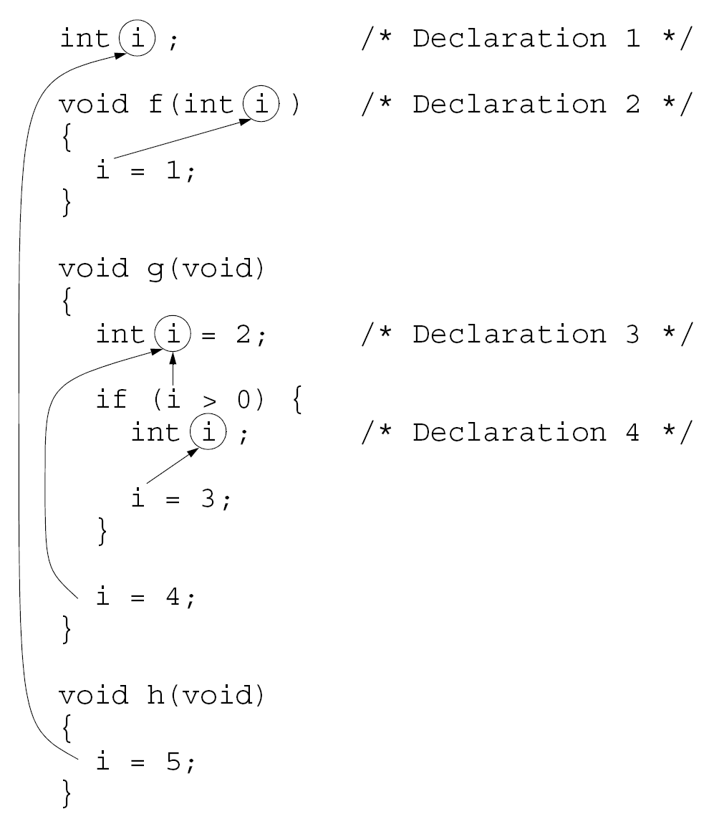

Slide 37
Organizing a C Program
Major elements of a C program:
Preprocessing directives such as #include and #define
Type definitions
Declarations of external variables
Function prototypes
Function definitions

Slide 38
Organizing a C Program
C imposes only a few rules on the order of these items:
A preprocessing directive doesn’t take effect until the line on which it appears.
A type name can’t be used until it’s been defined.
A variable can’t be used until it’s declared.
It’s a good idea to define or declare every function prior to its first call.
C99 makes this a requirement.

Slide 39
Organizing a C Program
There are several ways to organize a program so that these rules are obeyed.
One possible ordering:
#include directives
#define directives
Type definitions
Declarations of external variables
Prototypes for functions other than main
Definition of main
Definitions of other functions

Slide 40
Organizing a C Program
It’s a good idea to have a boxed comment preceding each function definition.
Information to include in the comment:
Name of the function
Purpose of the function
Meaning of each parameter
Description of return value (if any)
Description of side effects (such as modifying external variables)

Slide 41
Program: Classifying a Poker Hand
The poker.c program will classify a poker hand.
Each card in the hand has a suit and a rank.
Suits: clubs, diamonds, hearts, spades
Ranks: two, three, four, five, six, seven, eight, nine, ten, jack, queen, king, ace
Jokers are not allowed, and aces are high.
After reading a hand of five cards, the program will classify the hand using the categories on the next slide.
If a hand falls into two or more categories, the program will choose the best one.

Slide 42
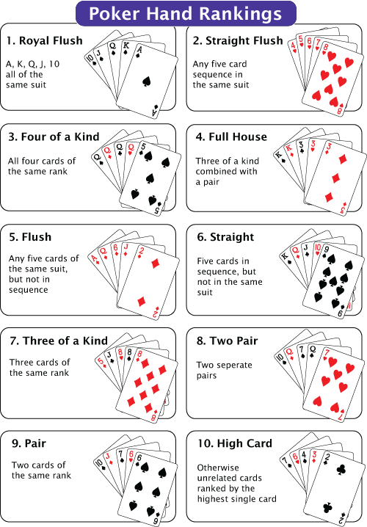
Program: Classifying a Poker Hand
Categories (listed from best to worst):
straight flush (both a straight and a flush)
four-of-a-kind (four cards of the same rank)
full house (a three-of-a-kind and a pair)
flush (five cards of the same suit)
straight (five cards with consecutive ranks)
three-of-a-kind (three cards of the same rank)
two pairs
pair (two cards of the same rank)
high card (any other hand)

Slide 43
Program: Classifying a Poker Hand
For input purposes, ranks and suits will be single letters (upper- or lower-case):
Ranks: 2 3 4 5 6 7 8 9 t j q k a
Suits: c d h s
Actions to be taken if the user enters an illegal card or tries to enter the same card twice:
Ignore the card
Issue an error message
Request another card
Entering the number 0 instead of a card will cause the program to terminate.

Slide 44
Program: Classifying a Poker Hand
A sample session with the program:
Enter a card: 2s
Enter a card: 5s
Enter a card: 4s
Enter a card: 3s
Enter a card: 6s
Straight flush

Slide 45
Program: Classifying a Poker Hand
Enter a card: 8c
Enter a card: as
Enter a card: 8c
Duplicate card; ignored.
Enter a card: 7c
Enter a card: ad
Enter a card: 3h
Pair

Slide 46
Program: Classifying a Poker Hand
Enter a card: 6s
Enter a card: d2
Bad card; ignored.
Enter a card: 2d
Enter a card: 9c
Enter a card: 4h
Enter a card: ts
High card
Enter a card: 0

Slide 47
Program: Classifying a Poker Hand
The program has three tasks:
Read a hand of five cards
Analyze the hand for pairs, straights, and so forth
Print the classification of the hand
The functions readCards, analyzeHand, and printResult will perform these tasks.
main does nothing but call these functions inside an endless loop.

Slide 48
Program: Classifying a Poker Hand
The functions will need to share a fairly large amount of information, so we’ll have them communicate through external variables.
readCards will store information about the hand into several external variables.
analyzeHand will then examine these variables, storing its findings into other external variables for the benefit of printResult.

Slide 49
Program: Classifying a Poker Hand
Program outline:
/* #include directives go here */
/* #define directives go here */
/* declarations of external variables go here */
/* prototypes */
void readCards(void);
void analyzeHand(void);
void printResult(void);

Slide 50
Program: Classifying a Poker Hand
int main(void)
{
for (;;) {
readCards();
analyzeHand();
printResult();
}
}
/**********************************************************
* readCards: Reads the cards into external variables; *
* checks for bad cards and duplicate cards. *
**********************************************************/
void readCards(void)
{
…
}

Slide 51
Program: Classifying a Poker Hand
/**********************************************************
* analyzeHand: Determines whether the hand contains a *
* straight, a flush, four-of-a-kind, *
* and/or three-of-a-kind; determines the *
* number of pairs; stores the results into *
* external variables. *
**********************************************************/
void analyzeHand(void)
{
…
}
/**********************************************************
* printResult: Notifies the user of the result, using *
* the external variables set by *
* analyzeHand. *
**********************************************************/
void printResult(void)
{
…
}

Slide 52
Program: Classifying a Poker Hand
How should we represent the hand of cards?
analyzeHand will need to know how many cards are in each rank and each suit.
This suggests that we use two arrays, numInRank and numInSuit.
numInRank[r] will be the number of cards with rank r.
numInSuit[s] will be the number of cards with suit s.
We’ll encode ranks as numbers between 0 and 12.
Suits will be numbers between 0 and 3.

Slide 53
Program: Classifying a Poker Hand
We’ll also need a third array, cardExists, so that readCards can detect duplicate cards.
Each time readCards reads a card with rank r and suit s, it checks whether the value of cardExists[r][s] is true.
If so, the card was previously entered.
If not, readCards assigns true to cardExists[r][s].

Slide 54
Program: Classifying a Poker Hand
Both the readCards function and the analyzeHand function will need access to the numInRank and numInSuit arrays, so they will be external variables.
The cardExists array is used only by readCards, so it can be local to that function.
As a rule, variables should be made external only if necessary.

Slide 55
/* Classifies a poker hand */
#include <stdbool.h> /* C99 only */
#include <stdio.h>
#include <stdlib.h>
#define NUM_RANKS 13
#define NUM_SUITS 4
#define NUM_CARDS 5
/* external variables */
int numInRank[NUM_RANKS];
int numInSuit[NUM_SUITS];
bool straight, flush, four, three;
int pairs; /* can be 0, 1, or 2 */
poker.c

Slide 56
/* prototypes */
void readCards(void);
void analyzeHand(void);
void printResult(void);
/**********************************************************
* main: Calls readCards, analyzeHand, and printResult *
* repeatedly. *
**********************************************************/
int main(void)
{
for (;;) {
readCards();
analyzeHand();
printResult();
}
}

Slide 57
/**********************************************************
* readCards: Reads the cards into the external *
* variables numInRank and numInSuit; *
* checks for bad cards and duplicate cards. *
**********************************************************/
void readCards(void)
{
bool cardExists[NUM_RANKS][NUM_SUITS];
char ch, rankCh, suitCh;
int rank, suit;
bool badCard;
int cardsRead = 0;
for (rank = 0; rank < NUM_RANKS; rank++)
{
numInRank[rank] = 0;
for (suit = 0; suit < NUM_SUITS; suit++)
cardExists[rank][suit] = false;
}
for (suit = 0; suit < NUM_SUITS; suit++)
numInSuit[suit] = 0;

Slide 58
while (cardsRead < NUM_CARDS)
{
badCard = false;
printf("Enter a card: ");
rankCh = getchar();
switch (rankCh)
{
case '0': exit(EXIT_SUCCESS);
case '2': rank = 0; break;
case '3': rank = 1; break;
case '4': rank = 2; break;
case '5': rank = 3; break;
case '6': rank = 4; break;
case '7': rank = 5; break;
case '8': rank = 6; break;
case '9': rank = 7; break;
case 't': case 'T': rank = 8; break;
case 'j': case 'J': rank = 9; break;
case 'q': case 'Q': rank = 10; break;
case 'k': case 'K': rank = 11; break;
case 'a': case 'A': rank = 12; break;
default: badCard = true;
}

Slide 59
suitCh = getchar();
switch (suitCh)
{
case 'c': case 'C': suit = 0; break;
case 'd': case 'D': suit = 1; break;
case 'h': case 'H': suit = 2; break;
case 's': case 'S': suit = 3; break;
default: badCard = true;
}
while ((ch = getchar()) != '\n')
if (ch != ' ') badCard = true;
if (badCard) printf("Bad card; ignored.\n");
else if (cardExists[rank][suit])
printf("Duplicate card; ignored.\n");
else {
numInRank[rank]++;
numInSuit[suit]++;
cardExists[rank][suit] = true;
cardsRead++;
}
}// end of while
}// end of readCards()

Slide 60
/**********************************************************
* analyzeHand: Determines whether the hand contains a *
* straight, a flush, four-of-a-kind, *
* and/or three-of-a-kind; determines the *
* number of pairs; stores the results into *
* the external variables straight, flush, *
* four, three, and pairs. *
**********************************************************/
void analyzeHand(void)
{
int numConsec = 0;
int rank, suit;
straight = false;
flush = false;
four = false;
three = false;
pairs = 0;

Slide 61
/* check for flush */
for (suit = 0; suit < NUM_SUITS; suit++)
if (numInSuit[suit] == NUM_CARDS)
flush = true;
/* check for straight */
rank = 0;
while (numInRank[rank] == 0) rank++;
for (; rank < NUM_RANKS && numInRank[rank] > 0; rank++)
numConsec++;
if (numConsec == NUM_CARDS) {
straight = true;
return;
}
/* check for 4-of-a-kind, 3-of-a-kind, and pairs */
for (rank = 0; rank < NUM_RANKS; rank++) {
if (numInRank[rank] == 4) four = true;
if (numInRank[rank] == 3) three = true;
if (numInRank[rank] == 2) pairs++;
}
}

Slide 62
/**********************************************************
* printSesult: Prints the classification of the hand, *
* based on the values of the external *
* variables straight, flush, four, three, *
* and pairs. *
**********************************************************/
void printResult(void)
{
if (straight && flush) printf("Straight flush");
else if (four) printf("Four of a kind");
else if (three &&
pairs == 1) printf("Full house");
else if (flush) printf("Flush");
else if (straight) printf("Straight");
else if (three) printf("Three of a kind");
else if (pairs == 2) printf("Two pairs");
else if (pairs == 1) printf("Pair");
else printf("High card");
printf("\n\n");
}

